Slide 1












Study Case of Hydrogen Blending

Slide 2
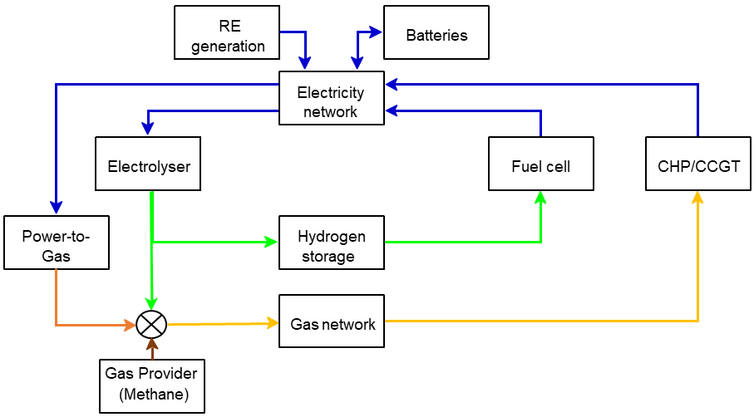
Study Case of Hydrogen Blending
Integrated Multi-Energy System
2

Slide 3
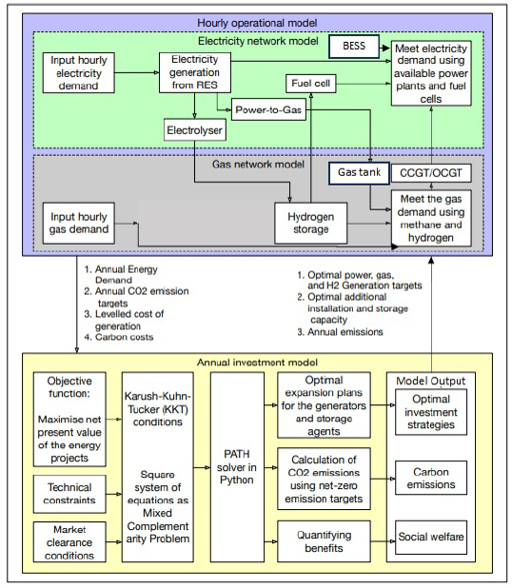
Study Case of Hydrogen Blending
Schematic Diagram of
Game-Theoretic Model
3

Slide 4
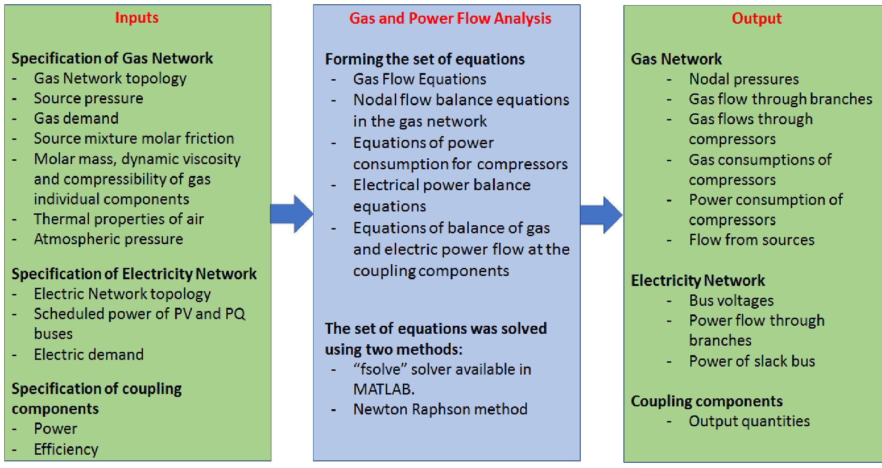
Study Case of Hydrogen Blending
The set of equations was solved by using two Python packages:
1-Pandapower for power network
2-Pandapipes for gas network
Schematic Diagram of OPGF
4

Slide 5
Study Case of Hydrogen Blending
Combining GT model with OPGF model
Iterative updates: GT model output ➔ OPGF output ➔ GT model
Flow chart of algorithm to perform the short-term operation and long term investment simulation
5

Slide 6
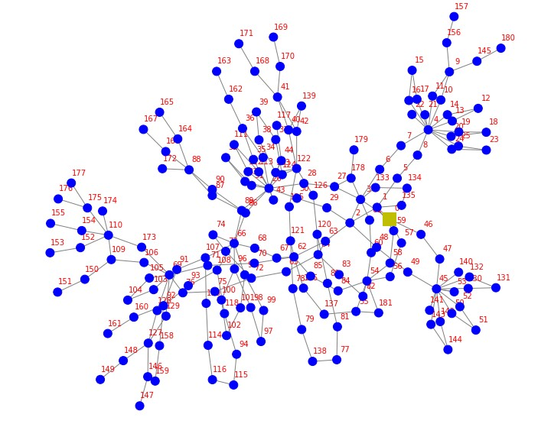
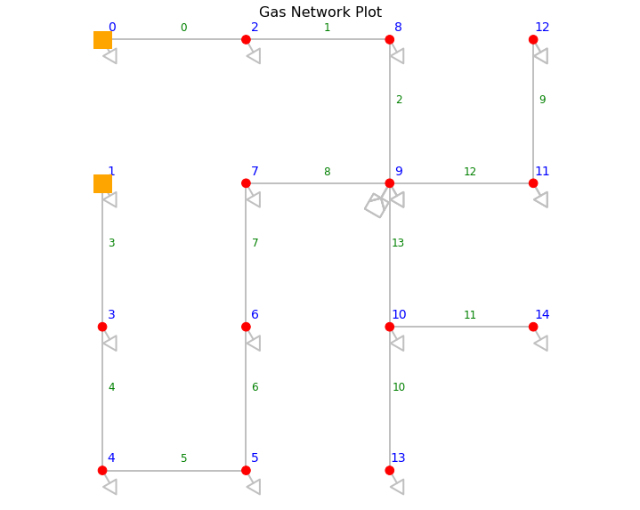
Study Case of Hydrogen Blending
Case study utilizes data from the North of Tyne region.
Power Network
Gas Network
6

Slide 7
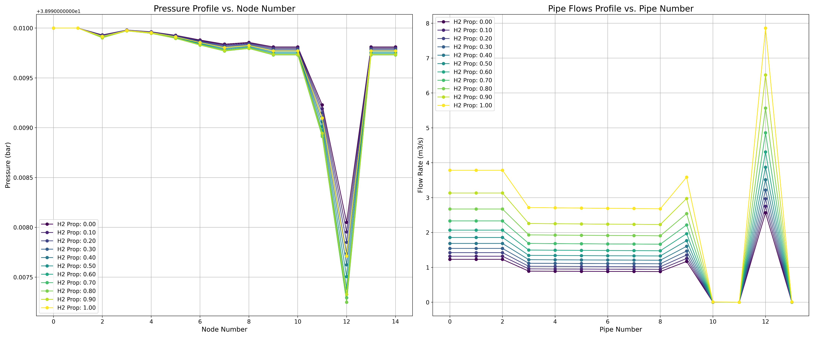
Study Case of Hydrogen Blending
Results
7

Slide 8
Study Case of Hydrogen Blending
Results
OPGF
H2_prop | Total Cost | Total Gas Energy Sinks | Total Gas Energy Sources | Total Gas Energy Externals | Total Flow Rate Sinks | Total Flow Rate Sources | Total Flow Rate Externals
 | (£) | (MWh) | (MWh) | (MWh) | (m3/s) | (m3/s) | (m3/s)
0 | 8881.084 | 98.365 | 20.797 | 77.568 | 2.690 | 0.569 | 2.122
0.1 | 8881.559 | 98.385 | 20.797 | 77.588 | 2.886 | 0.610 | 2.276
0.2 | 8882.135 | 98.409 | 20.797 | 77.611 | 3.112 | 0.658 | 2.454
0.3 | 8882.849 | 98.438 | 20.798 | 77.640 | 3.376 | 0.713 | 2.663
0.4 | 8883.756 | 98.475 | 20.798 | 77.678 | 3.689 | 0.779 | 2.910
0.5 | 8884.948 | 98.524 | 20.798 | 77.726 | 4.066 | 0.858 | 3.208
0.6 | 8886.583 | 98.591 | 20.798 | 77.793 | 4.529 | 0.956 | 3.574
0.7 | 8888.963 | 98.689 | 20.798 | 77.891 | 5.112 | 1.077 | 4.035
0.8 | 8892.752 | 98.845 | 20.799 | 78.046 | 5.868 | 1.235 | 4.633
0.9 | 8899.721 | 99.132 | 20.799 | 78.332 | 6.890 | 1.446 | 5.444
1 | 8916.779 | 99.833 | 20.800 | 79.033 | 8.367 | 1.743 | 6.624
8

Slide 9
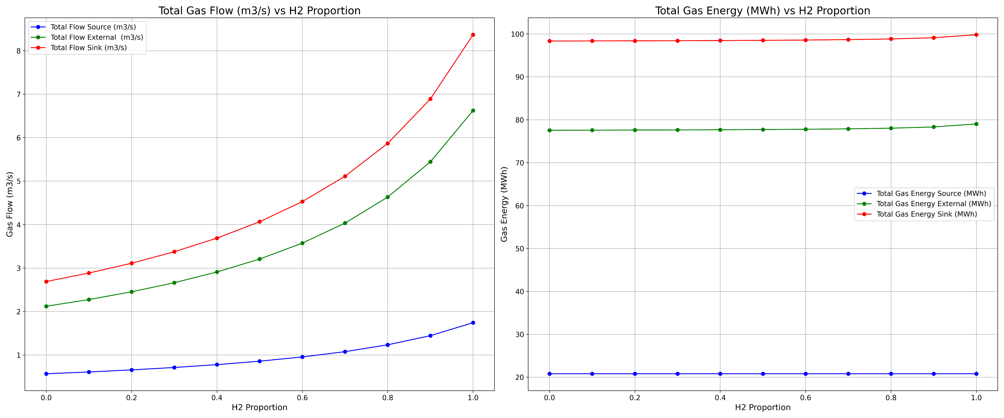
Study Case of Hydrogen Blending
Results
9

Slide 10
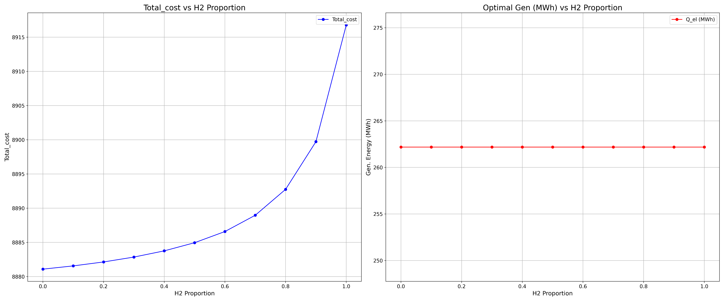
Study Case of Hydrogen Blending
Results
10

Slide 11
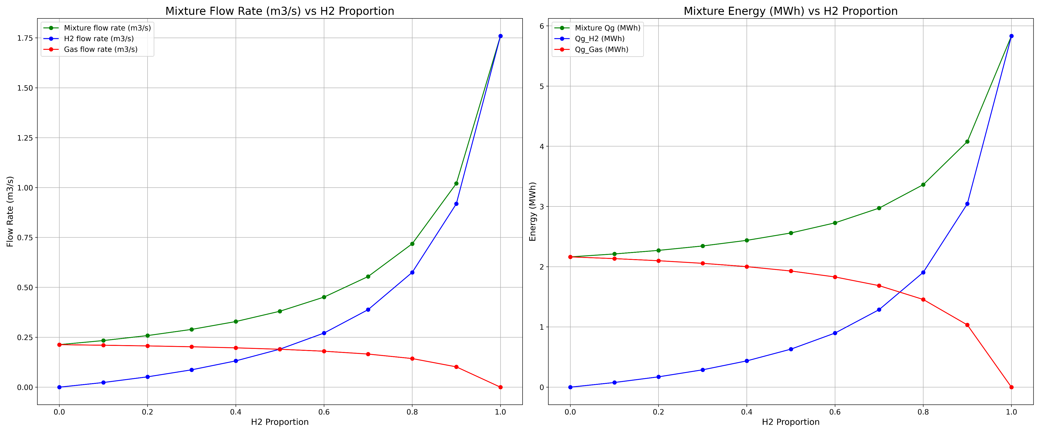
Study Case of Hydrogen Blending
Results
11

Slide 12
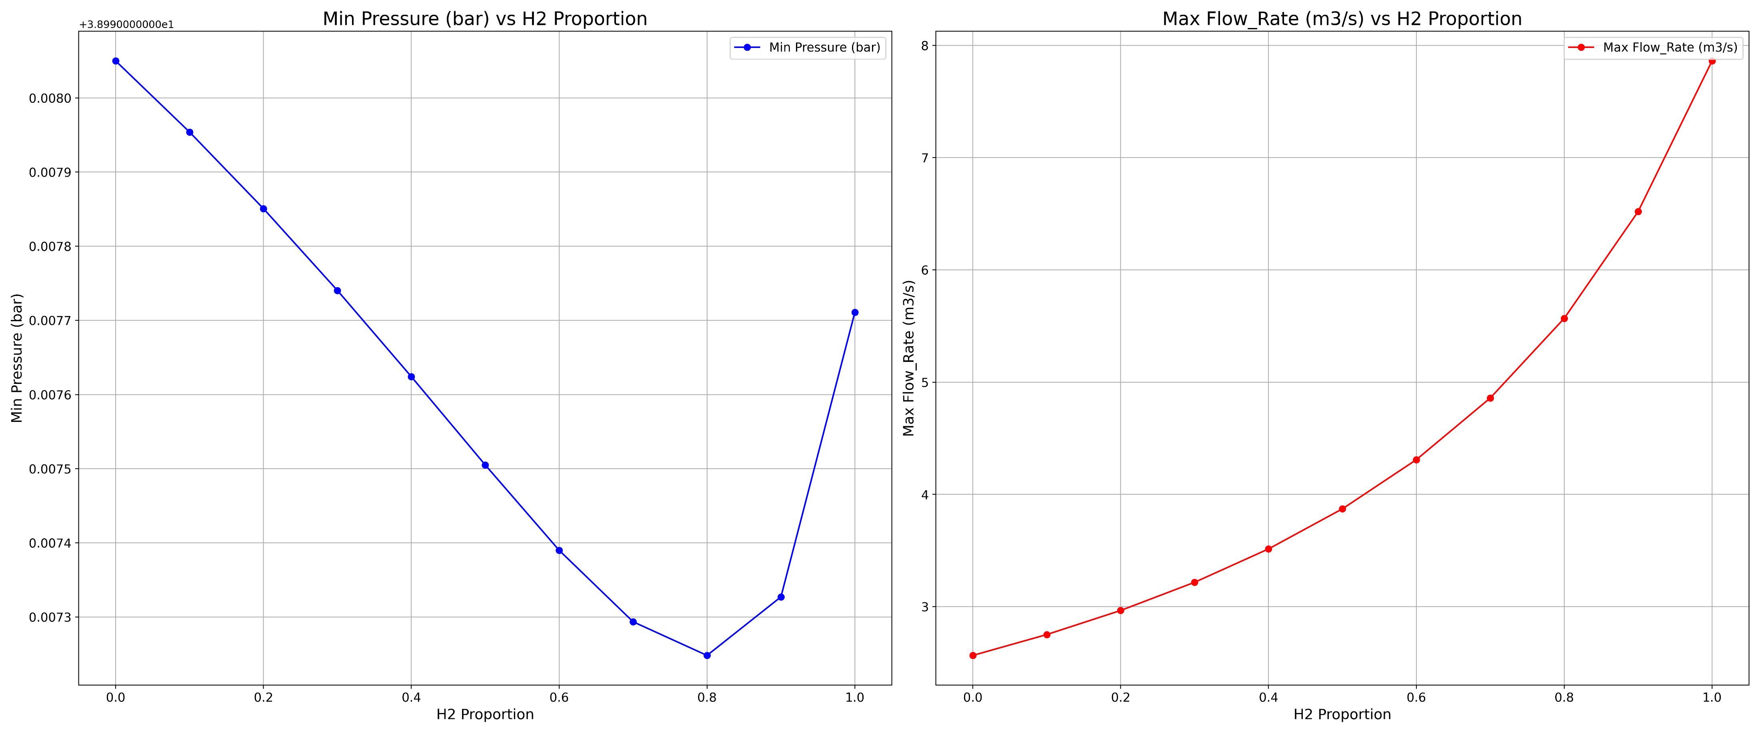
Study Case of Hydrogen Blending
Results
Fixed energy output at sinks
12

Slide 13
Study Case of Hydrogen Blending
Techno-economic Analysis
H2 Proportion | Cost GT | Cost_ OPGF | Cost Difference | NPV | Total Supply | Total Demand | Emissions GT | Emissions OPGF
0 | 75366.44 | 120621.69 | -45255.26 | 57623.59 | 557.96 | 557.96 | 318.76 | 965.21
0.1 | 73690.35 | 118156.95 | -44466.60 | 59818.51 | 558.38 | 558.38 | 308.17 | 931.48
0.2 | 71750.16 | 115990.18 | -44240.02 | 62360.21 | 558.88 | 558.88 | 296.27 | 901.71
0.3 | 69546.65 | 112388.24 | -42841.59 | 65256.56 | 559.51 | 559.51 | 282.65 | 850.54
0.4 | 66886.52 | 108210.15 | -41323.63 | 68791.39 | 560.31 | 560.31 | 265.66 | 792.96
0.5 | 63705.12 | 103817.32 | -40112.20 | 72991.18 | 561.35 | 561.35 | 246.07 | 731.25
0.6 | 59801.56 | 97921.71 | -38120.15 | 78246.06 | 562.79 | 562.79 | 221.32 | 649.45
0.7 | 54923.81 | 90998.50 | -36074.70 | 84798.73 | 564.88 | 564.88 | 190.89 | 552.43
0.8 | 48403.73 | 82064.51 | -33660.78 | 92795.86 | 568.20 | 568.20 | 149.84 | 427.13
0.9 | 39334.12 | 68683.05 | -29348.93 | 101445.73 | 574.32 | 574.32 | 92.54 | 240.05
1 | 28758.90 | 53208.43 | -24449.53 | 114073.17 | 589.29 | 589.29 | 23.35 | 23.20
13

Slide 14
Study Case of Hydrogen Blending
Techno-economic Analysis
Player Type | Generation Capacity (MWh) vs. H2-Prop
 | 0.0 | 0.1 | 0.2 | 0.3 | 0.4 | 0.5 | 0.6 | 0.7 | 0.8 | 0.9 | 1.0
CHP | 19.70 | 19.57 | 18.94 | 19.71 | 19.64 | 19.72 | 19.65 | 19.70 | 19.77 | 17.16 | 5.76
EZ | 0.00 | 7.12 | 15.36 | 25.00 | 36.44 | 50.26 | 67.26 | 88.72 | 116.69 | 154.92 | 211.06
FC | 0.00 | 7.12 | 15.36 | 25.00 | 36.44 | 50.26 | 67.26 | 88.72 | 116.69 | 154.92 | 211.06
G2P | 122.93 | 122.59 | 122.73 | 123.12 | 122.53 | 123.01 | 122.47 | 122.82 | 123.32 | 126.55 | 127.05
GT | 85.30 | 85.28 | 85.83 | 85.40 | 85.06 | 85.18 | 84.82 | 84.79 | 78.81 | 49.50 | 14.31
P2G | 26.00 | 26.00 | 26.00 | 26.00 | 26.00 | 26.00 | 26.00 | 26.00 | 26.00 | 26.00 | 26.00
Biomass | 18.06 | 18.34 | 18.31 | 17.95 | 18.43 | 18.14 | 18.50 | 18.40 | 18.65 | 18.97 | 19.11
Meth | 201.88 | 194.84 | 186.71 | 177.20 | 165.94 | 152.39 | 135.78 | 114.92 | 87.94 | 51.64 | 0.00
Solar | 7.42 | 7.63 | 7.58 | 7.34 | 7.62 | 7.46 | 7.63 | 7.59 | 7.77 | 7.90 | 8.00
Wind | 50.68 | 50.71 | 50.77 | 50.69 | 50.99 | 50.80 | 51.29 | 51.08 | 51.23 | 52.51 | 52.54
14

Slide 15
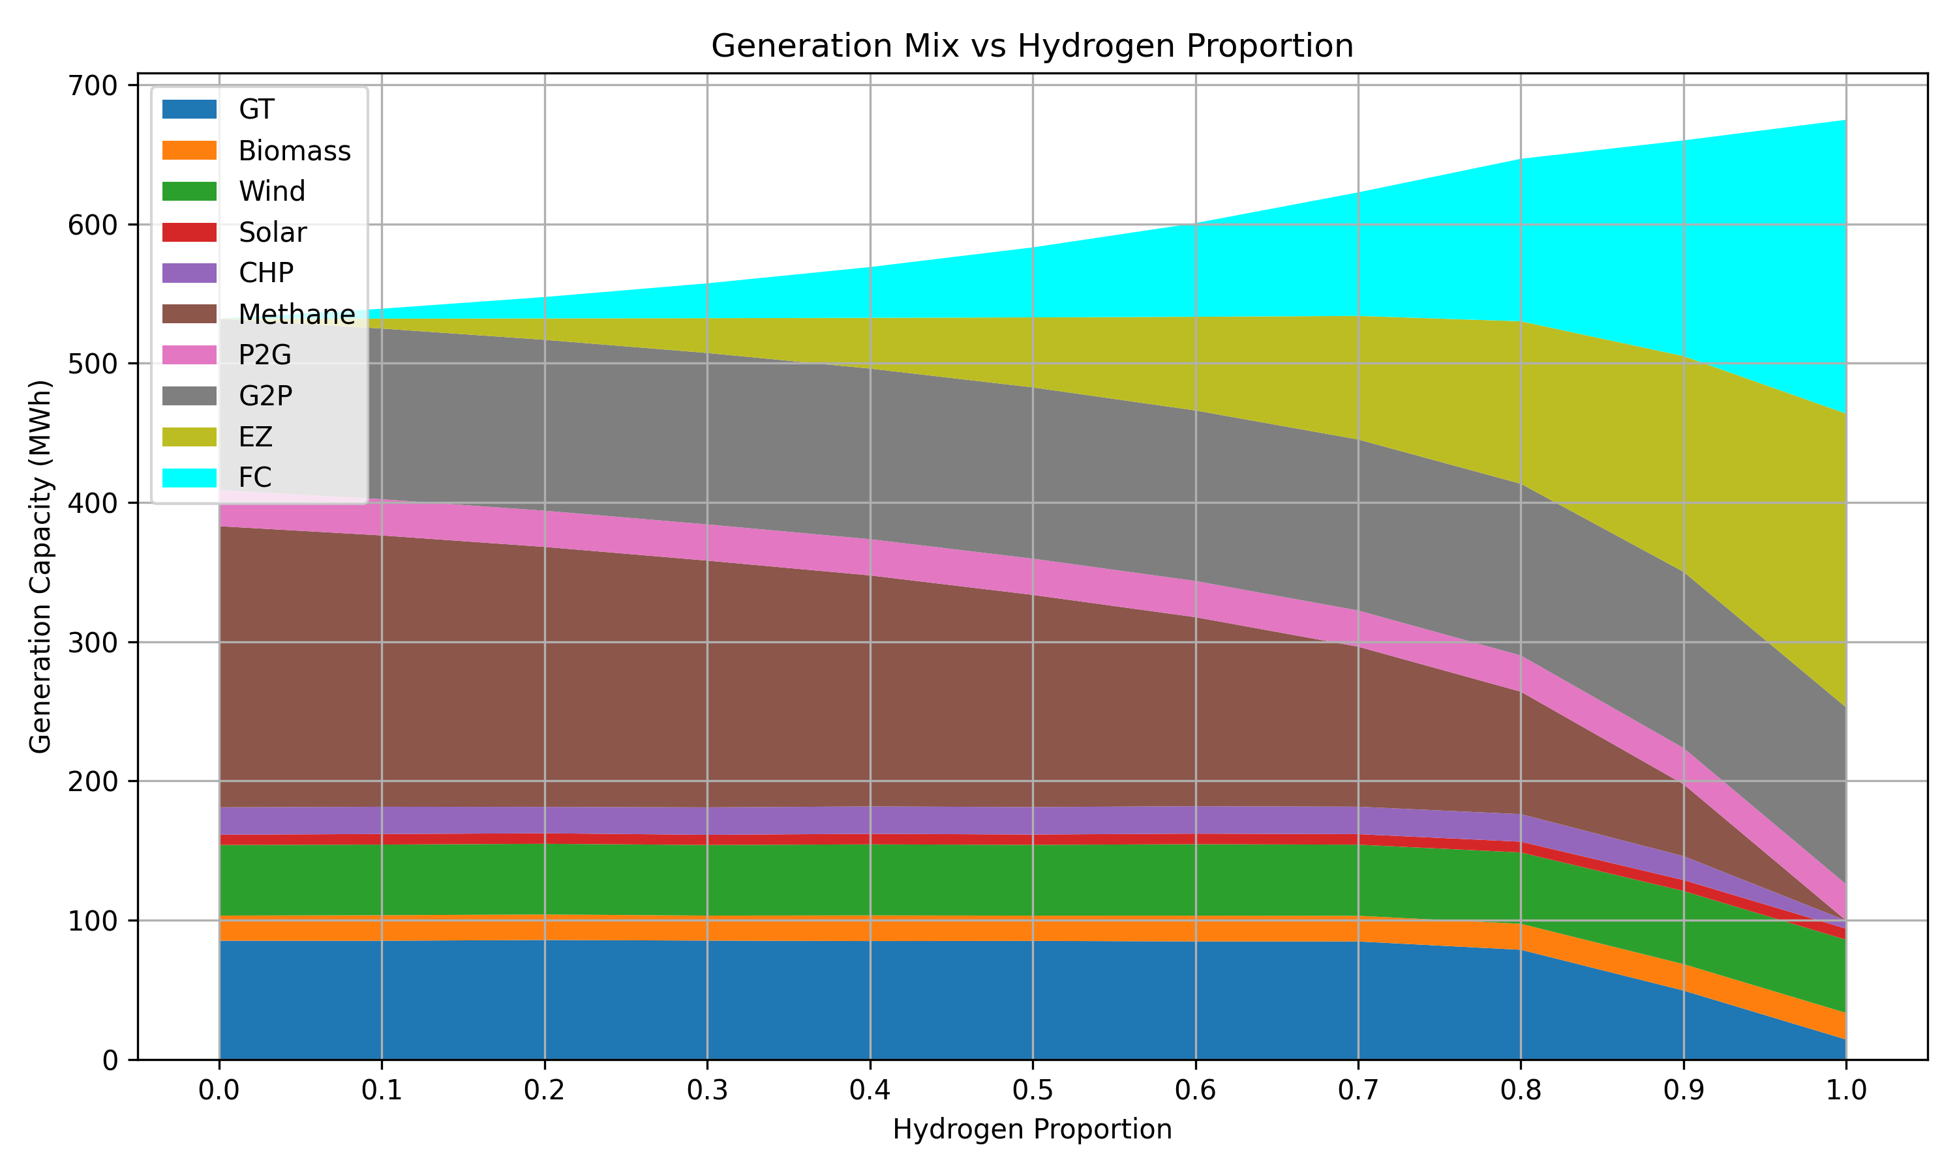
Study Case of Hydrogen Blending
Techno-economic Analysis
15

Slide 16
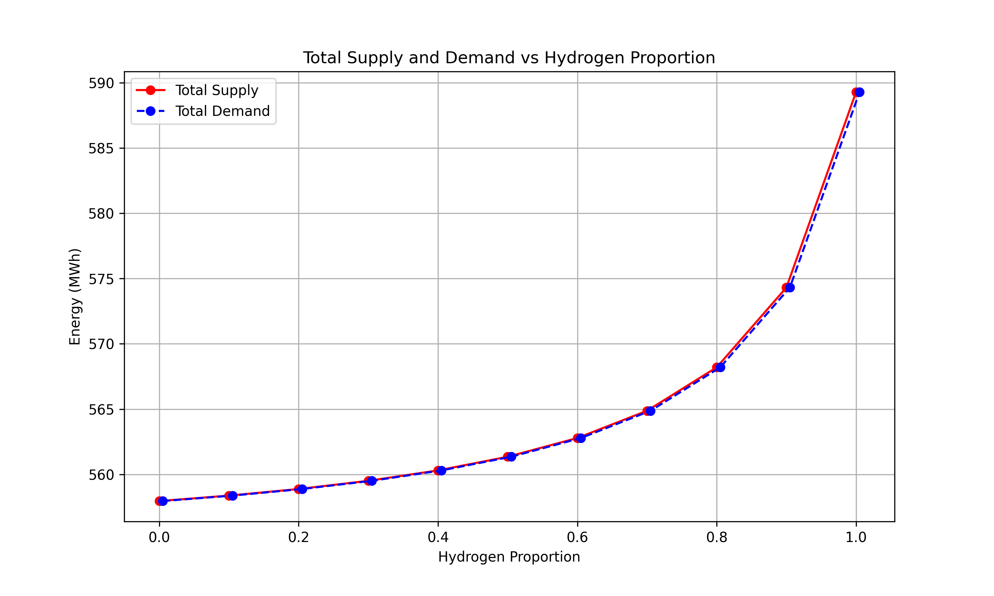
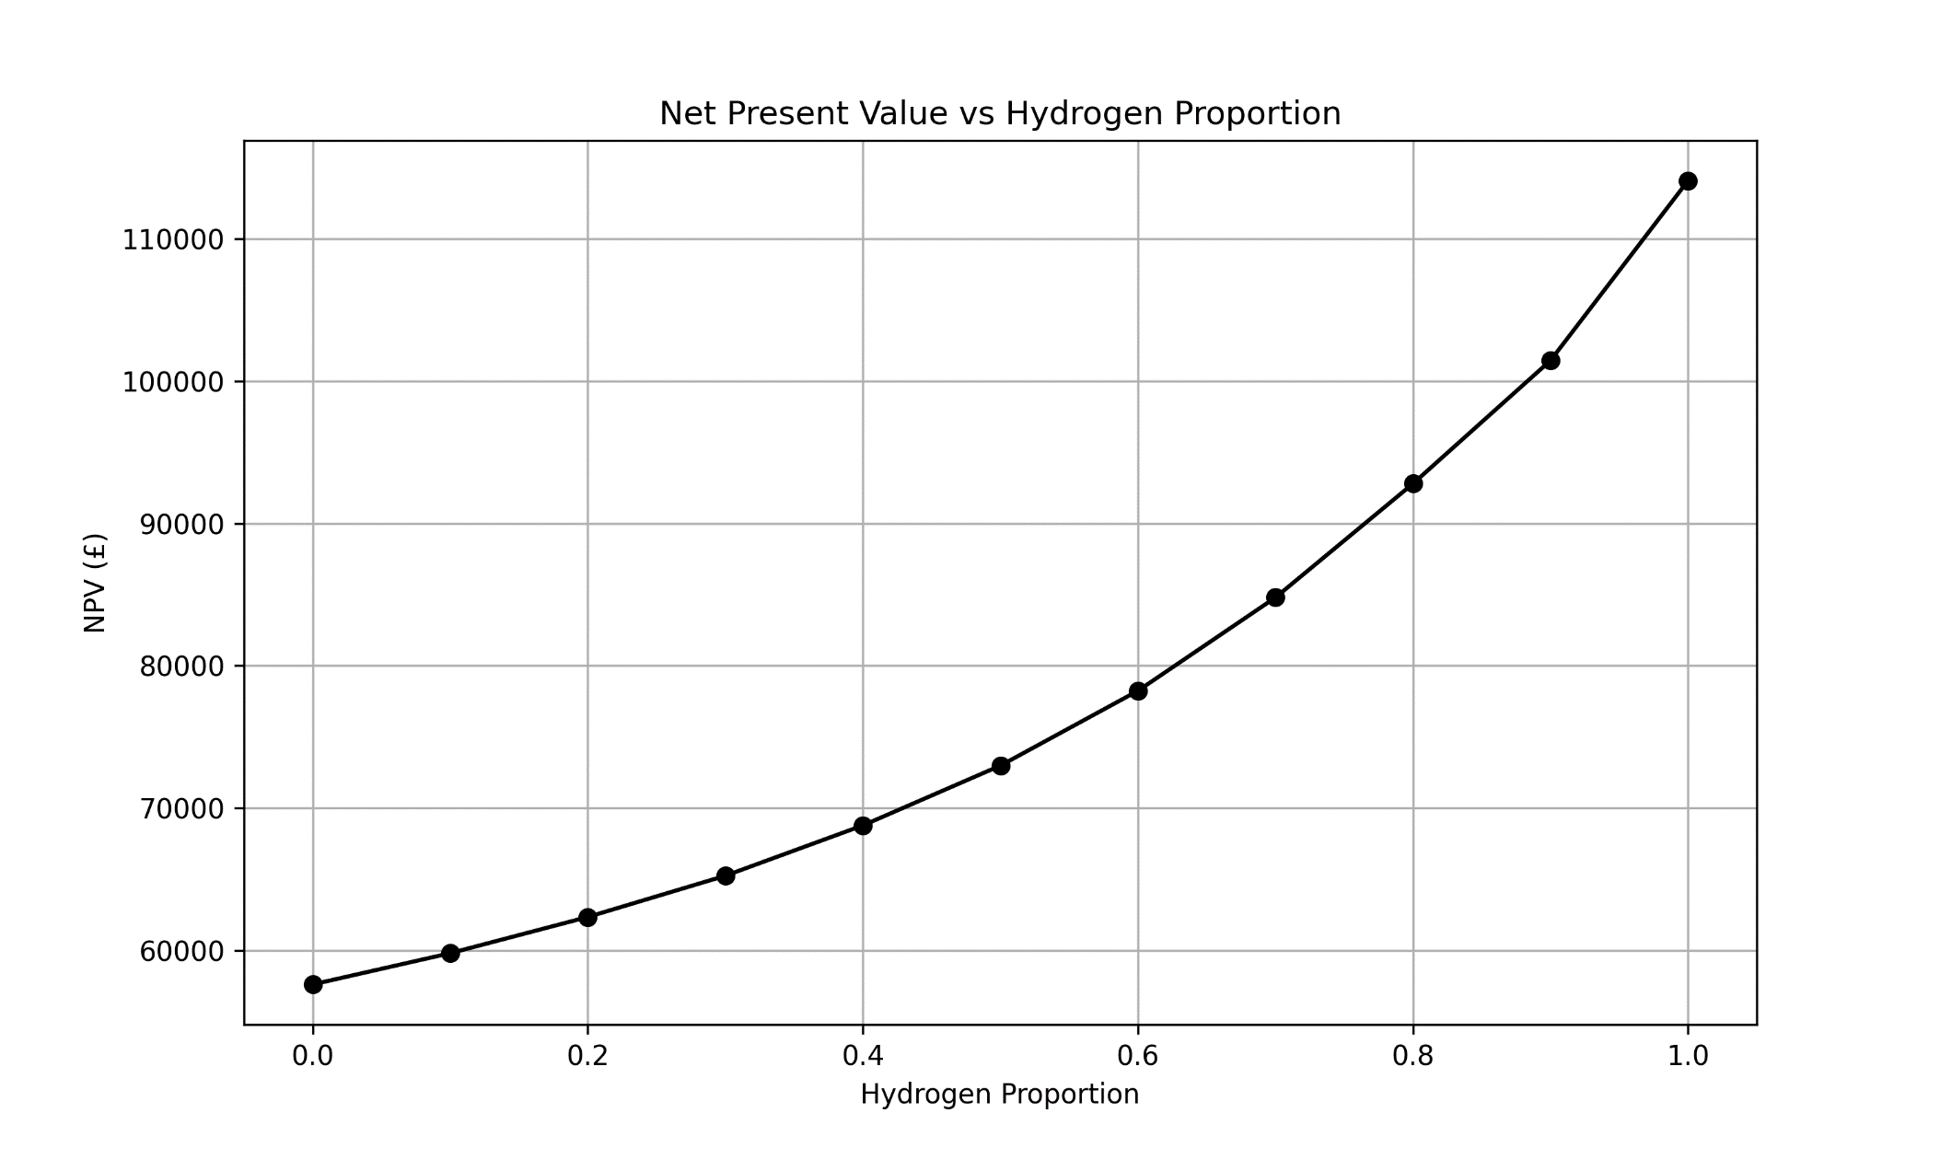
Study Case of Hydrogen Blending
Techno-economic Analysis
16

Slide 17
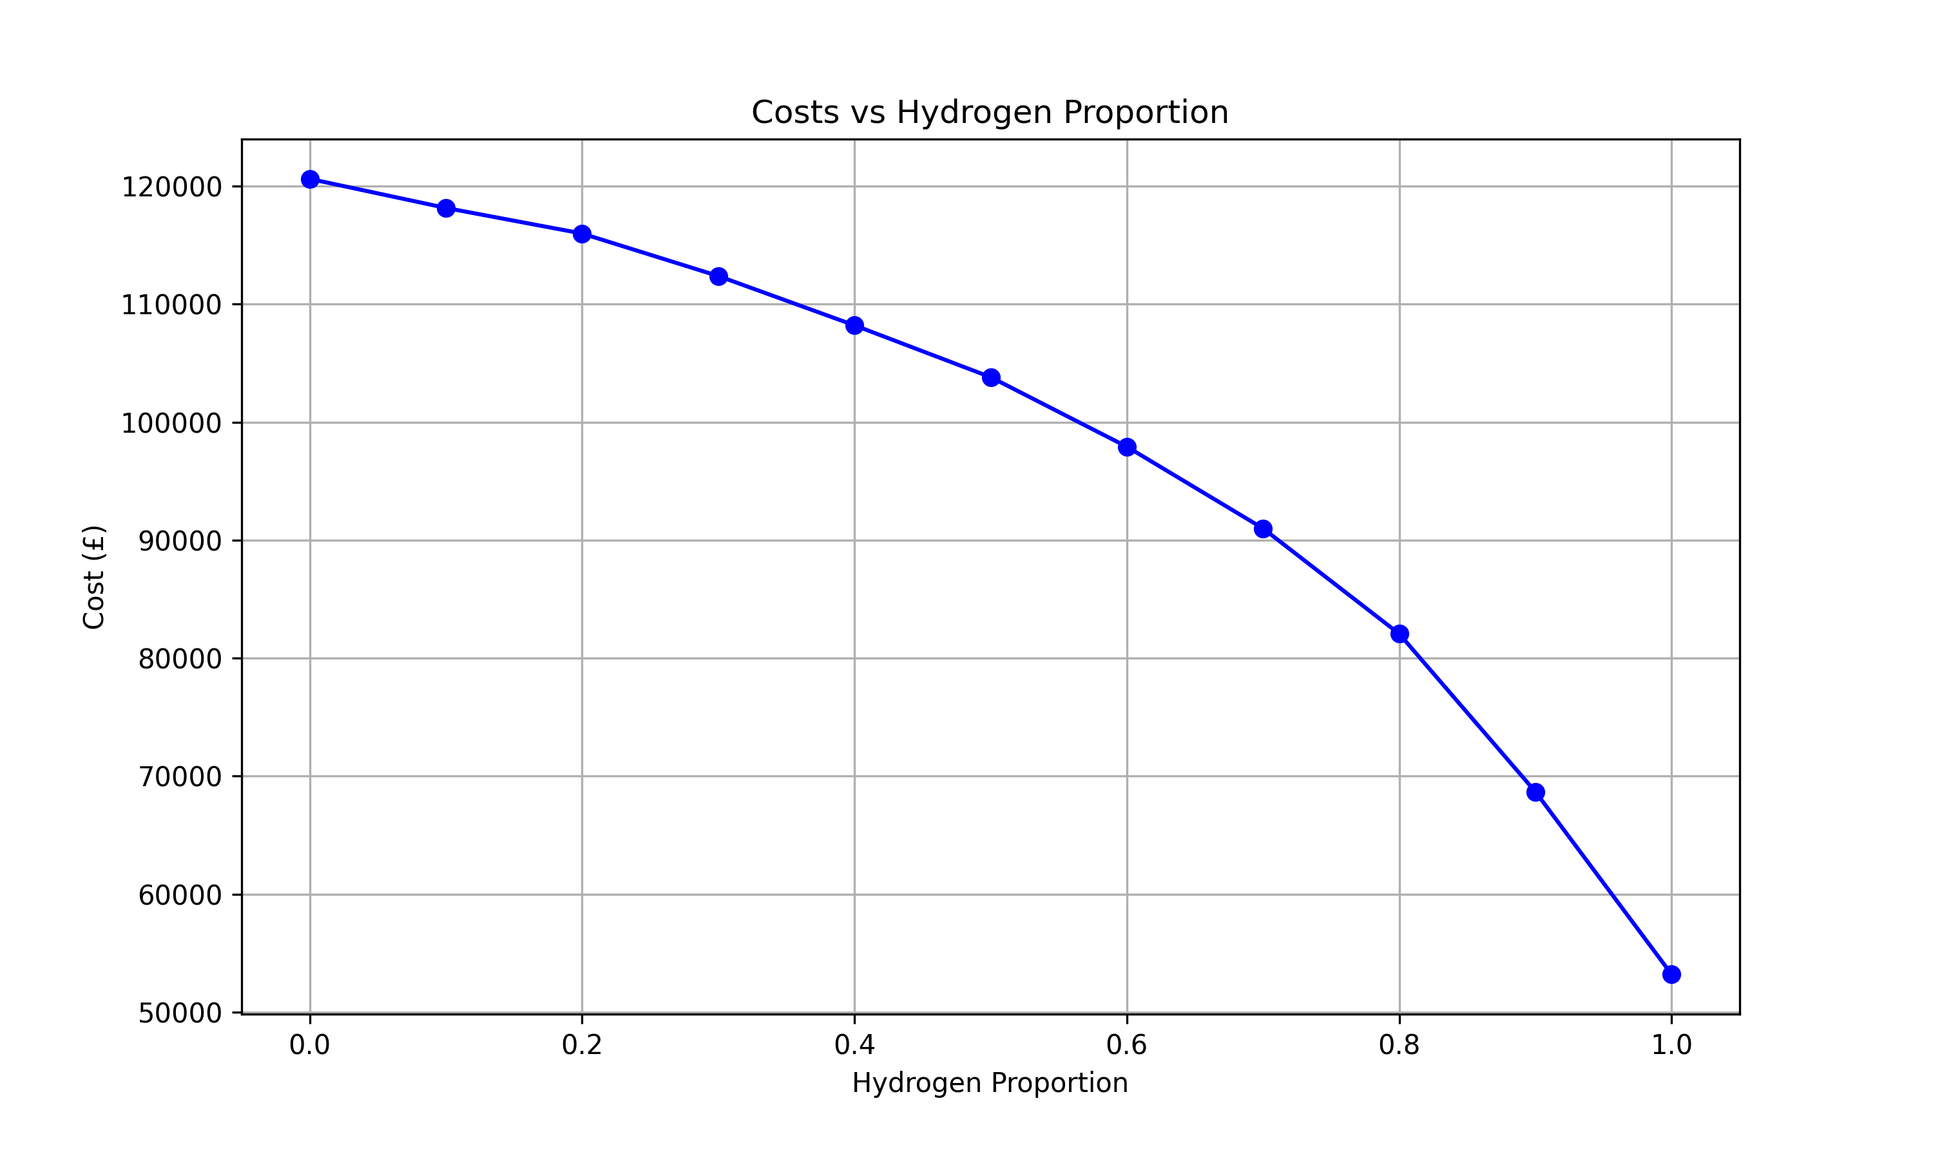
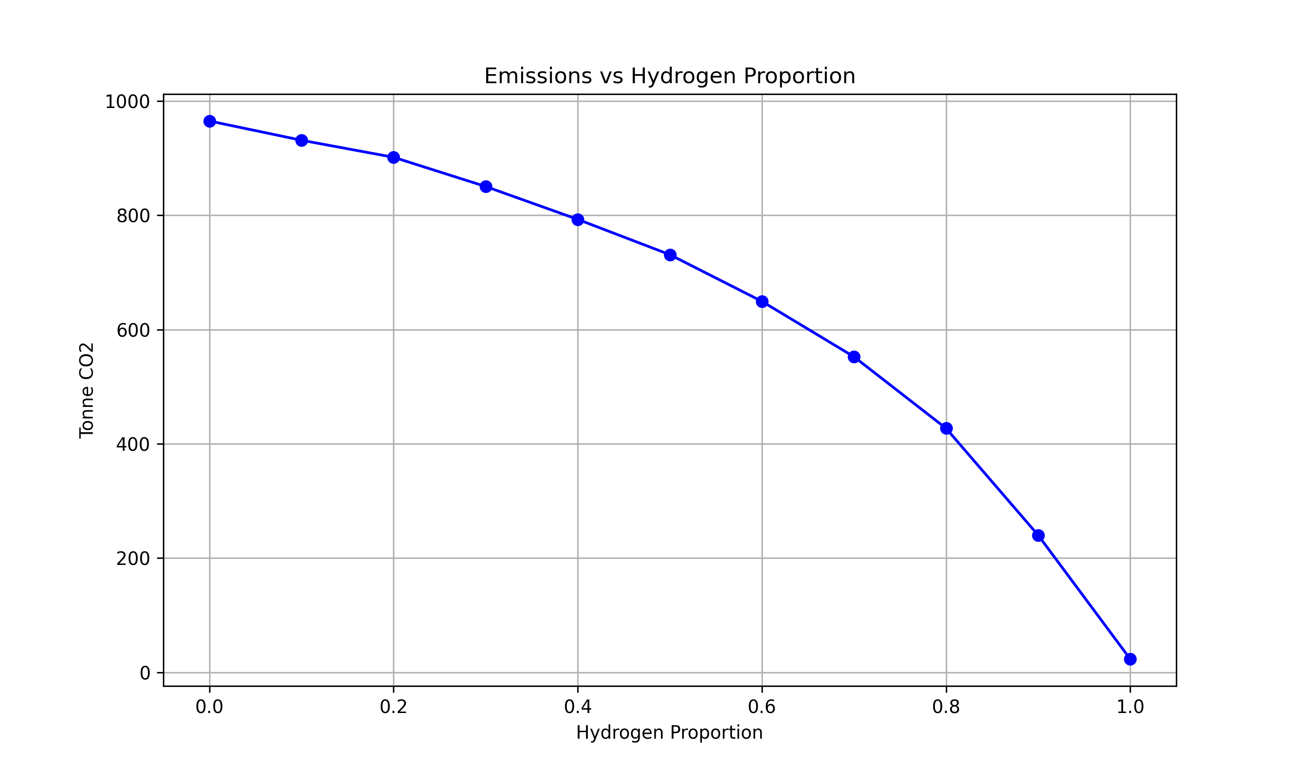
Study Case of Hydrogen Blending
Techno-economic Analysis
17

Slide 18
Thank you for your attention

